Slide 1
Visual ERPs through FDA
Jacopo Lazzari

Slide 2
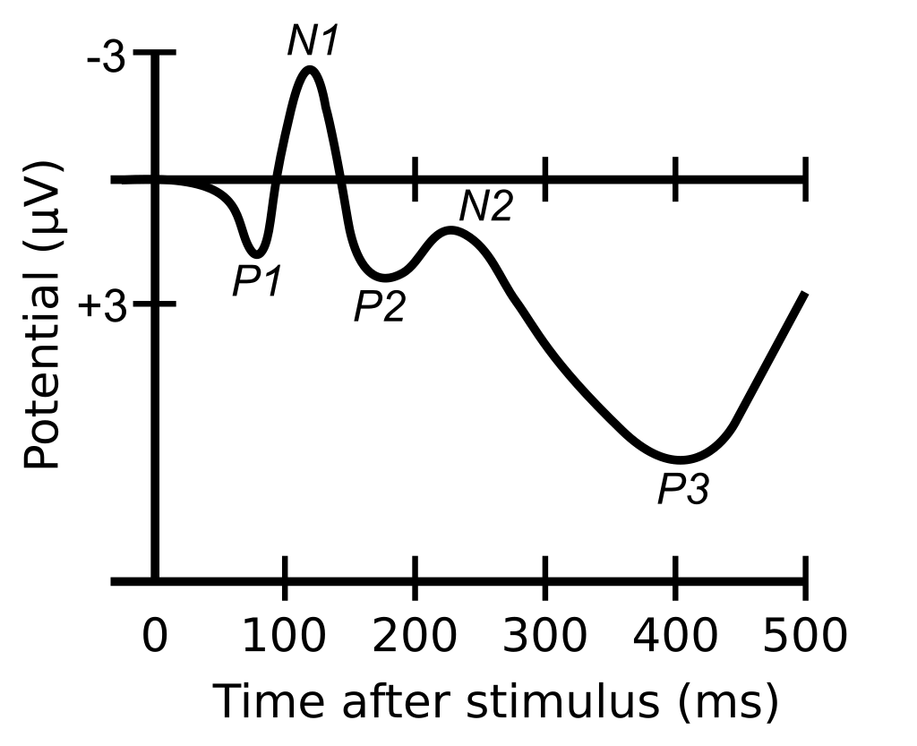
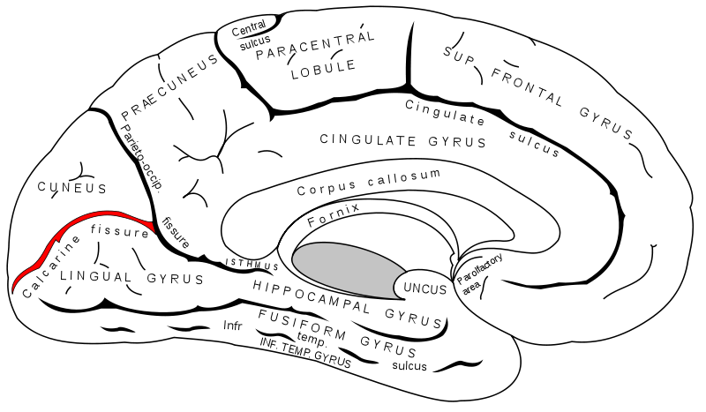
Components
C1: [p. 74]
Variable polarity
Mostly detectable in electrodes above calcarine fissure
P1: [p. 75]
Largest at lateral occipital electrodes
Modulated by selective attention and arousal
Sensitive to faces and categories^{[1]}

Slide 3
Components
N1: [p. 76]
Several subcomponents
Earliest peaks 100-150 ms ps in anterior electrodes
150-200 ms from parietal and lateral occipital cortex
Lateral occipital subcomponents reflect discriminative processing
N170: [p. 77]
Faces vs non faces stimuli
150-200 ms at central midline sites
Right hemisphere in lateral occipital electrodes

Slide 4
Components
P2: [p. 79]
Anterior and central scalp sites
Lagest for stimuli containing target features
N2: [P. 82]
Anterior vs Posterior N2
Target vs nontarget
P3: [p. 95]
No clear consesus about what cognitive process is reflected
Sensitive to temporal probability of the stimulus’ category
Stimulus categorization (frequent vs rare)

Slide 5
Our dataset
64 electrodes
Rapid Serial Visual Presentation
Passive task
5 categories to discriminate
Grootswagers, T., Zhou, I., Robinson, A.K. Et al. Human EEG recordings for 1,854 concepts presented in rapid serial visual presentation streams. Sci Data 9, 3 (2022). https://doi.org/10.1038/s41597-021-01102-7

Slide 6
SOA
Both amplitude and latency are considered through peak amplitude and peak latency [p. 284]
These measures can be improved [P. 293->302]
ANOVA-based (corrected with Bonferroni) [p. 312->315, Online chapter 13]
Usually only two categories are considered (es. animal vs tool)
More categories in the last decade through ML^{[1]}

Slide 7
What do we bring?
Focus on Occipital cortex^{[1]}
fPCA^{[2]} without alignment to preserve latency information
Extract discrete measures (es. peak amplitude of components, peak latency, area amplitude ^{[3]} & fractional area latency + jacknife approach ^{[4]} ) [p. 320->328]
Linear correlation to analyze associations between discrete variables and PCFs
[1] Qin Y, Zhan Y, Wang C, Zhang J, Yao L, Guo X, Wu X, Hu B. Classifying four-category visual objects using multiple ERP components in single-trial ERP. doi: 10.1007/s11571-016-9378-0. Epub 2016 Feb 18. PMID: 27468316; PMCID: PMC4947051.
[2] Kipp K, Johnson ST, Hoffman MA. Functional principal component analysis of H-reflex recruitment curves. J Neurosci Methods. 2011 Apr 30;197(2):270-3. doi: 10.1016/j.jneumeth.2011.03.005.
[3] A Common Neural Mechanism for Preventing and Terminating the Allocation of Attention. Risa Sawaki, Joy J. Geng, Steven J. Luck. Journal of Neuroscience 1 August 2012, 32 (31) 10725-10736; DOI: 10.1523/JNEUROSCI.1864-12.2012
[4] Kiesel A, Miller J, Jolicoeur P, Brisson B. Measurement of ERP latency differences: a comparison of single-participant and jackknife-based scoring methods. Psychophysiology. 2008 Mar;45(2):250-74. doi: 10.1111/j.1469-8986.2007.00618.x. Epub 2007 Nov 7. PMID: 17995913.

Slide 8
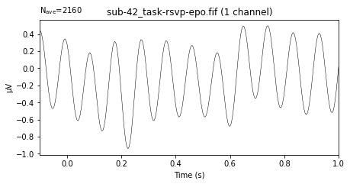
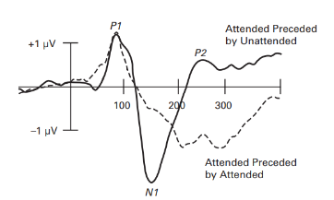
Problems
Many stimuli presented sequentially at a fast, regular rate [P. 111-112]
N1 component is highly refractory [p.77]

